Slide 1
ECORD
Outreach and Education
Task Force
#7
27-28 January 2015, Nancy

Slide 2
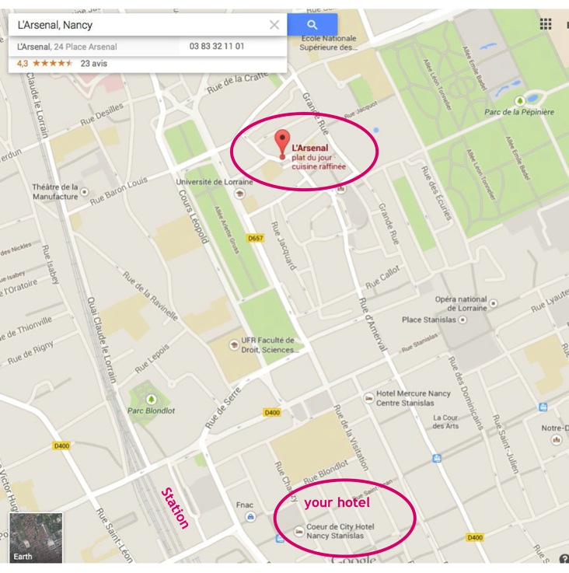
Welcome and Logistics
ECORD Outreach & Education Task Force Meeting #7
Tue 27 (full day) room R02
Wed 28 (morning) room R02
Internet access
Lunches at the CNRS restaurant
Dinner on Wednesday evening
at l’Arsenal (map)
Modifications to the agenda?
ECORD O&E TF #7, January 27-28, 2015, Nancy

Slide 3
1. Actions from meeting #6
2) ECORD science publications online
Action PM –JPG, NH: to set up a strategy in Dec/Jan on how to post ECORD science publications on line – in progress
3) ECORD activities
Action AS: to provide contact in Turkey to G. Camoin
3) COL/CDEX
Action PM: to contact MW about the number of issues to be sent to ECORD
3) ICDP
Actions TW and GC regarding IODP-ICDP Amphibious Proposals
Action ML: to check worshop reports in previous SD issues
4) Newsletter
Action AS: to contact B.B. Jorgensen to get a report of Exp 347
4) New IODP brochure
Action PM,All: to start a layout and text of a new brochure “How to get involved” to continue the discussion in January 2015
ECORD O&E TF #7, January 27-28, 2015, Nancy

Slide 4
1. Actions (cont.)
4) New IODP brochure
Action GC: to present a draft at next IODP Forum in July 2015 in Canberra
5) AGU 2014
Action PM to contact Charna Meth about the format of the Primer Workshop and see with TW if it could be adapted to EGU 2015
6) Websites
Action EMA: to make a list of contents of the ECORD wikipedia section including keywords for each paragraph – in progress
Action PM : to propose new categories to reorganise the ECORD homepage
7) Education
Action ESSAC: to inform teachers applying for expeditions they will not be paid during the expedition.
ECORD O&E TF #7, January 27-28, 2015, Nancy

Slide 5
2. ECORD and ICDP news
Outreach & Education ECORD activities
EMA
ESSAC
ESO
ICDP
ECRD Outreach & Education TF Meeting, 4-5/2/2014, Bremen
ECORD O&E TF #7, January 27-28, 2015, Nancy

Slide 6
2. ECORD and ICDP news
Outreach and education activities
@ AGU 2014
Joint ECORD/IODP – ICDP exhibition booth
Scientific Drilling Town Hall meeting
Support to ECORD booths
IODP-Canada @ GSA 2014 in Vancouver
IODP-France @RST 2014 in Pau
Programme publications
ECORD Newsletter #23 – November 2014; ECORD Calendar 2015
involved in IODP-ICDP brochure
ECORD online
Updates/new pages on ecord.org
Distribution of ECORD Headlines #5
Meetings
Report at Council/ESSAC meeting #2 on E&O 2014 activities and 2015 budget
Informal IODP education meeting @AGU 2014
ECRD Outreach & Education TF Meeting, 4-5/2/2014, Bremen
ECORD O&E TF #7, January 27-28, 2015, Nancy

Slide 7
2. ECORD and ICDP news
Outreach & Education ECORD activities
EMA
ESSAC
ESO
ICDP
ECRD Outreach & Education TF Meeting, 4-5/2/2014, Bremen
ECORD O&E TF #6, Sept 3-4, 2014, Zurich

Slide 8
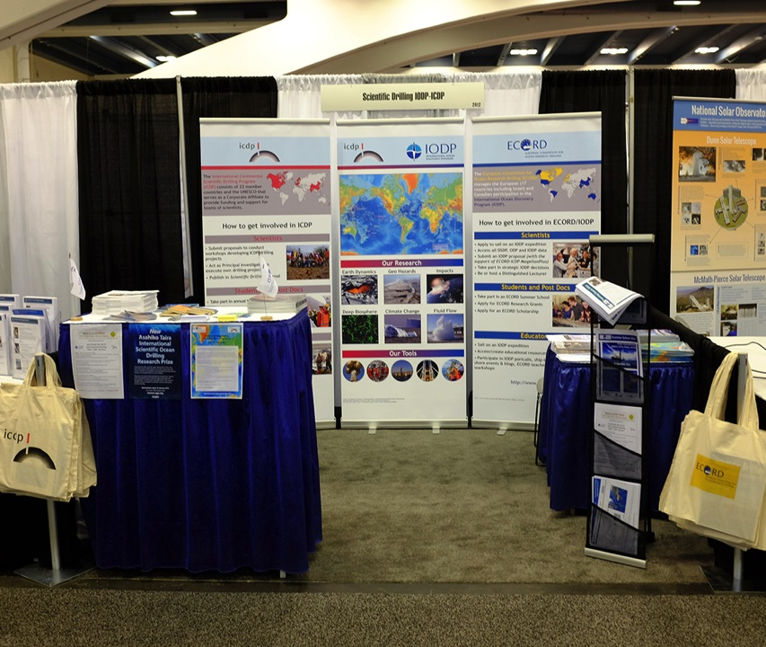
3. Review of IODP-ICDP @ AGU 2014
Scientific Drilling IODP-ICDP booth (15-19 December)
Co-funded by ECORD and ICDP
1st day of the meeting (6 to 8 pm)
3,5 days (until Fri 2 pm)
ECORD-ICDP team: Alan, Diane (IODP-Canada), Sarah, Carola and Uli.
Located in NSF street, nearby COL/USIO and JAMSTEC/KCC booths
Steady traffic (24,000 attendees at AGU 2014)
New ECORD/IODP-ICDP posters
ECRD Outreach & Education TF Meeting, 4-5/2/2014, Bremen
ECORD O&E TF #7, January 27-28, 2015, Nancy

Slide 9
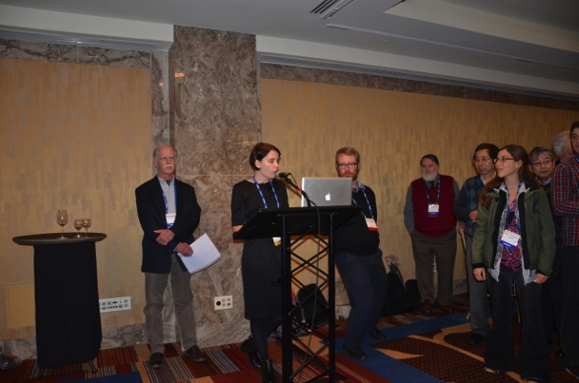
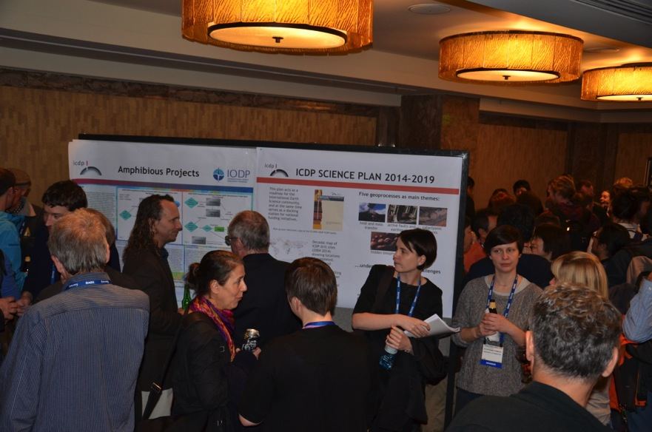
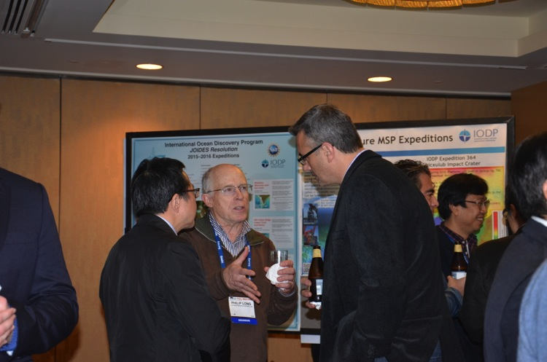
3. Review of IODP-ICDP @ AGU 2014
Scientific Drilling Town Hall Meeting (Hilton Hotel, Tu 16 December)
250-300 attendees, open bar + food
2 speakers, 24 posters, organised by COL and co-funded by participants (NSF, ICDP, JAMSTEC & ECORD).
ECRD Outreach & Education TF Meeting, 4-5/2/2014, Bremen
ECORD O&E TF #7, January 27-28, 2015, Nancy

Slide 10
3. Review of IODP-ICDP @ AGU 2014
Exhibition Booth
Positive
Good attendance
Visible outside European countries
Show IODP-ICDP collaboration
Negative
Expensive shipping/travels, amenities
Better integration with US and Japanese colleagues. How?
Difficult to find us in the list of exhibitors
Too many flyers?
Town Hall meeting
Positive
Good attendance
Show integration/collaboration
Negative
Expensive event (esp. catering ≈ USD 29,000)
Low ceiling and small room => too noisy and difficult to move and see all posters
Posters were too many (17) and too specialised
Speakers were not introduced and not visible by all people in the room
ECRD Outreach & Education TF Meeting, 4-5/2/2014, Bremen
ECORD O&E TF #7, January 27-28, 2015, Nancy

Slide 11
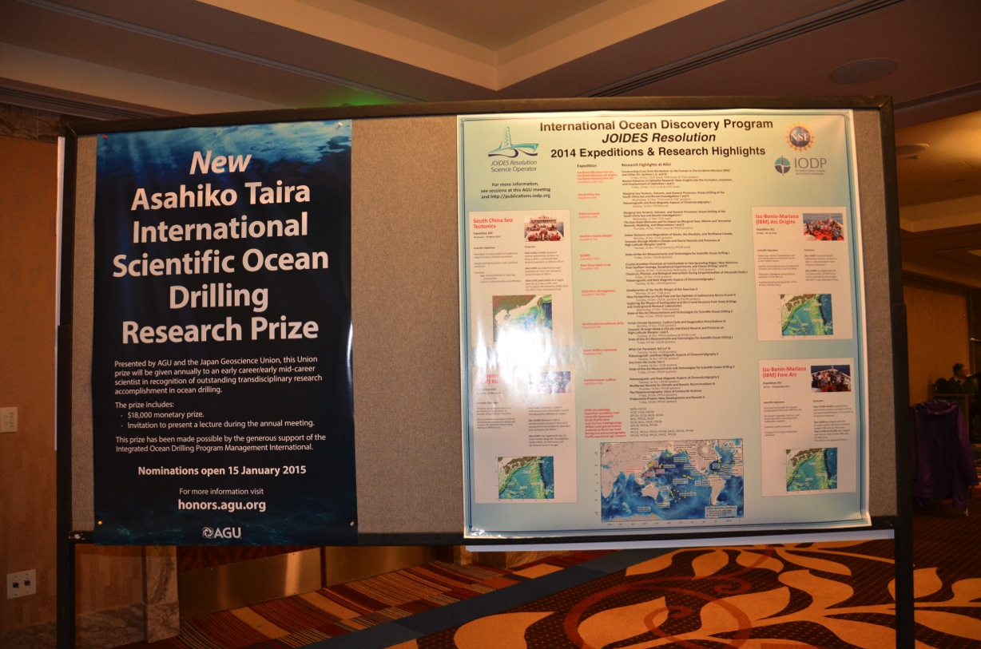
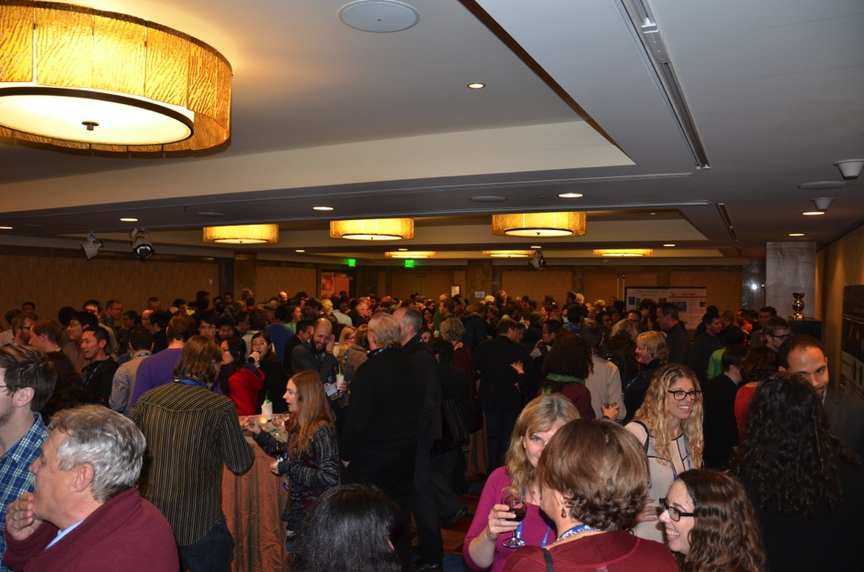
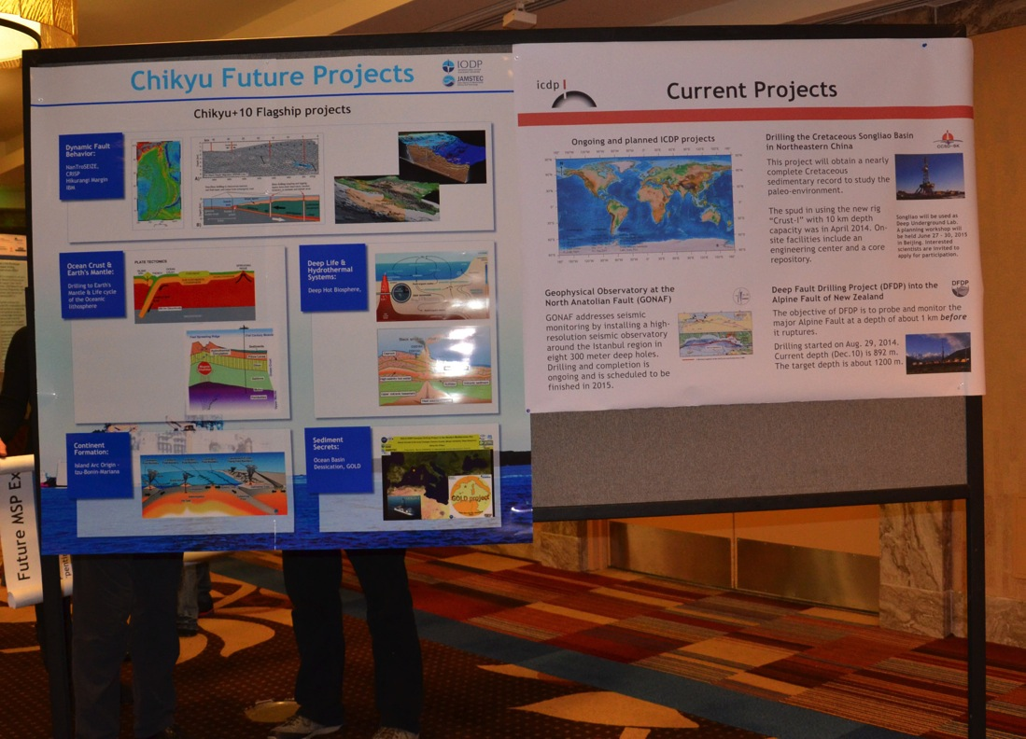
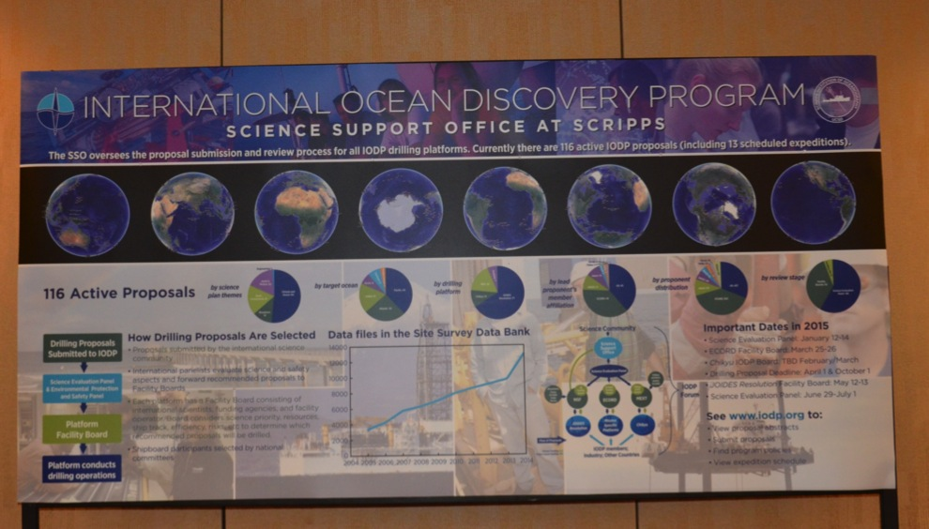
ECRD Outreach & Education TF Meeting, 4-5/2/2014, Bremen

Slide 12
4. Publications
ECORD Annual Report 2014: to be released early March 2015
Gilbert
IODP Book (publ. December 2014) @ EGU 2015 => Albert
Scientific Drilling: last and future issues => Thomas
Newsletter #24 - April 2015
Action Scientific Drilling Journal (GC)
On behalf of the editors to contact the IODP operators regarding the expedition science reports to be submitted by the Co-chiefs Scientists to Scientific Drilling journal
ECORD O&E TF #7, January 27-28, 2015, Nancy

Slide 13
4. Publications
ECORD Newsletter - Next issue #24 – April 2014 (AGU 2014)
Deadline for contributors: 15 March
Overview: Gilbert and M. Diament
MagellanPlus reports: Newfoundland drilling, S Atlantic
IODP Proposal: Maldives Monsoon (Exp 359)
IODP-ICDP Amphibious Proposals
Chikyu status and plans
ICDP new science plan
ECORD O&E TF #7, January 27-28, 2015, Nancy

Slide 14
5. Outreach & education activities in 2015
Plans for Exp 357 => Alan, Albert
Exhibition booths & related activities in 2015
EGU 2015 http://www.egu2015.eu/
IODP-ICDP Exhibition booth, Townhall Meeting and
IODP-ICDP session
AGU 2015?
No specialised conferences in 2015
Support to IODP-ICDP Canada @AGU-GAC-MAC 2015
http://ja.agu.org/2015/
ECORD O&E TF #7, January 27-28, 2015, Nancy

Slide 15
5. Outreach & education activities in 2015
Support to IODP-ICDP Canada @AGU-GAC-MAC 2015
http://ja.agu.org/2015/
ECORD/IODP national events?
Support to JpGU 2015
Exhibition booths & related activities in 2016
IGC 2016, 27 Sept-4 Oct, Cape Town, South Africa
http://www.35igc.org/
Ocean 2016 (Gilbert)?
ECORD O&E TF #7, January 27-28, 2015, Nancy

Slide 16
5. Outreach & education activities in 2015
MagellanPlus: information and reports
http://www.ecord.org/magellanplus.html
Materials: core replicas (6), goodies, videos
PETM replica was given to ANZIC
J-FAST replica is offered by CDEX to ECORD - to be delivered on late March 2015
Additional materials (forams, thin sections, etc.) to go with the replicas
ECORD O&E TF #7, January 27-28, 2015, Nancy

Slide 17
5. Outreach & education activities in 2015
Videos
EPC to post logging videos online (EPC website and ESO
Youtube channel) if credits agreed.
Other projects:
Education: a project by Jean-Luc Bérenguer & Dan Brinkhuis as an outcome of Teachers at Sea (Exp 345) – no funding available
Joel Leyendecker: documentary on the geosphere for Arte (via B. Menez, IPGP): permission to use existing video footages on IODP Shimokita Exp was given - no news
Bruno Bucher: documentary on earthquakes for the French National TV): Shootings onboard the Chikyu (P. Henry, CEREGE/Collège de France) during Exp 348 as part of a documentary on earthquakes - no news
Dan Brinkhuis contacted ECORD to support him on Exp 354 Bengal Fan - no funding available
ECORD O&E TF #7, January 27-28, 2015, Nancy

Slide 18
5. Outreach & education activities in 2015
Education
ECORD Summer Schools 2015, Training Course, education officers
Julia
ECORD School of Rock 2015 in Portugal
ECORD O&E TF #7, January 27-28, 2015, Nancy

Slide 19
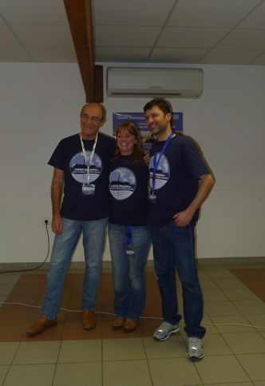
5. Outreach & education activities in 2015
ECORD School of Rock in Portugal
8-10 July 2015 in Loulé organised by Helder Pereira
25-30 Teachers + 10 Guests
Conferences and hands-on activities
Virtual guided tour of the BCR
Support/funding from local institute (hosting) and IODP Portugal for accommodation + travels of Portuguese scientists
ECORD support provided by ECORD O&E TF: goodies, core replicas
ECORD additional funding requested: 3,000 € for travels/accommodation of 3 non Portuguese guests (1800 €) and dinner (1200€)
(total budget of ECORD SOR in France: 15,000 € for 40 p. and 3 days)
ECORD O&E TF #7, January 27-28, 2015, Nancy

Slide 20
7. Future collaborations
Overarching IODP outreach & education activities
Outreach at IODP Forum
IODP Forum Action Item: Review of education and outreach activities across IODP will be a special focus of the second meeting of the Forum.
IODP Forum Action Item: ECORD E & O Task Force to discuss the concept of a simple IODP proposal brochure at its September 2014 meeting and provide a suggested course of action at the July 2015 Forum meeting.
With USA: possibilities to US teachers to take part in ECORD teachers activities
With Japan: to take part in SOR in Sendai focusing on Tohoku earthquake
ECORD O&E TF #7, January 27-28, 2015, Nancy

Slide 21
^{Dear Keir and Gilbert,}
I have no problem with the new paragraph.
At the Forum meeting, I noted that I was all in favour of producing such a brochure (presumably electronic but printable by anyone as a glossy paper version as needed), and I now think that it would be a great pity to defer any action until after the next Forum meeting in Canberra. I often get comments from people who think that the IODP process is 'too complicated' but have not dug into the website. Having a simple brochure setting out the key points would be a very considerable leap forward for those who are not yet 'in the club'.
My hope is that ECORD might decide to run with its production in September.If they costed the activity and called for financial support, I'm sure ANZIC would be willing to provide such support.Our guess is that, if approved text were provided to a designer, an elegant one or two page electronic brochure could be produced for a couple of thousand dollars - something of obvious value in many contexts!
In fact, Catherine Beasley, the ANZIC administrator, who thinks a lot about outreach and fielded many questions from non-cognescenti at the IODP booth at the recent Australian Earth Sciences Convention, suggests that IODP should produce a number of single page brochures as a matter of good business practice:
^{-How do I develop a proposal?}
-How can I secure a shipboard position?
^{-How can I get IODP data?}
-How can get IODP samples for my research? -How can I get an Educator position?
She says that a simple set of flyers would serve both to invite and encourage participation by interested folk,and also simply to inform the wider community of the array of opportunities we are providing, whether or not they are themselves interested in participating. We would certainly make such material available in all our ANZIC member organisations and at every conference and outreach activity we conduct.
^{With regards,}
^{Neville}
ECORD O&E TF #7, January 27-28, 2015, Nancy

Slide 22
7. Future collaborations
IODP - ICDP outreach & education activities?
For scientists: ‘Scientific Drilling’, MagellanPlus and booths
For students: Summer School/Training Course?
For general public: e.g. IODP-ICDP day (in Erlangen), Researchers’ Night (Haifa)
ECORD O&E TF #7, January 27-28, 2015, Nancy

Slide 23
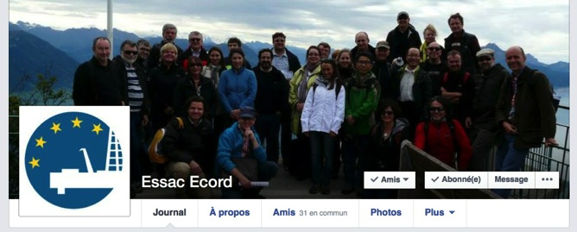
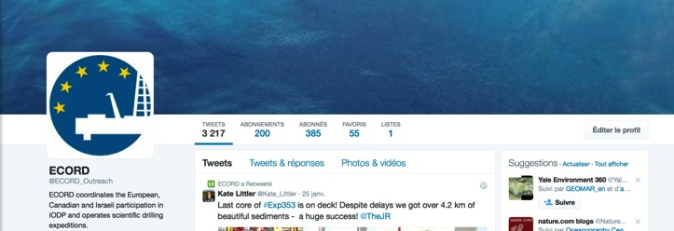
6. ECORD and ICDP online
ECORD Wikipedia: http://en.wikipedia.org/wiki/ECORD => EMA
ECORD websites
ECORD -> http://www.ecord.org/
ESO -> http://www.eso.ecord.org/
ESSAC -> http://www.essac.ecord.org
Need for an ECORD style guide
Social networks
ESSAC facebook (244)
ECORD twitter (387)
ECORD O&E TF #7, January 27-28, 2015, Nancy

Slide 24
6. ECORD and ICDP online
ECORD/IODP science publications
Collection of citations (via reports, Google scholar, Crossref , Web of science, etc.) with appropriate format (e.g. doi) to be exported,
Creating and feeding the database,
Post the list of citations + search the database on ecord.org.
In progress:
ESSAC has established lists of publications with help provided by national offices
Teresa Bingham-Müller is being recruited by ESSAC in Zurich (start in Feb 2015)
EMA-ESSAC meeting in Zurich will be organised on early February 2015
ECORD O&E TF #7, January 27-28, 2015, Nancy

Slide 25
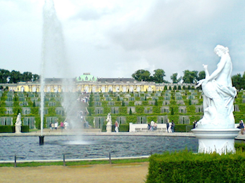
8. Next meetings
ECORD-IODP-ICDP TF meeting
September 2015? In Potsdam
(Host: ICDP @ GFZ)
ECORD – ICDP TF meeting
Early 2016? Where?
ECORD O&E TF #7, January 27-28, 2015, Nancy

